Slide 1
Why Cryptosystems Fail
2020.11.12
Lee Jisup, Samnieng Tan

Slide 2
Contents
Introduction
ATM
How ATM Fraud Takes Place
The Wider Implications
A New Security Paradigm
Conclusions

Slide 3
1. Introduction
Information
Government
bank
Cryptology
Other Organisations

Slide 4
1. Introduction
Aircraft crashes
CryptoSystem fails​
Investigate - insurer, manufacturer, …
secrecy
examine - journalists, politicians, …
Feedback

Slide 5
2. ATM
Usage of Cryptography
Government
Bank
World war II
New technology called automatic teller machines(ATM)

Slide 6
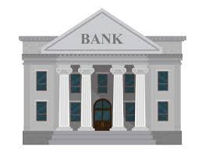
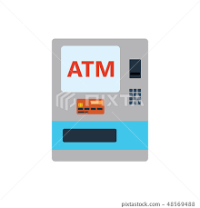
2. ATM
ATM security issues
Some countries include the US
Banks have to carry all the risks associated with ATM, which means banks are 100% responsible for the disputes if they cannot prove the customer’s fraud.
Britain
regulators and courts had not yet been demanding, and bankers deny that their systems fail even though the PIN system was insecure.
Phantom Withdrawal

Slide 7
2. ATM
An example of ATM security issues
Many court cases occurs by ATM
A teenage girl was convicted of stealing money from her father. It later turned out that there was a clerical error by the bank.
A police was charged with theft and suspended because of phantom withdrawl took place on a card which he had confiscated from a suspect. His colleagues tracked down the eyewitness who had made the transaction after the disputed one, and cleared him.

Slide 8
3. How ATM Fraud Takes Place
Some simple examples
By staff
Ex) Engineer record customers’ PINs by installing a computer in ATM. Then made up counterfeit cards and looted their accounts.
By outsider
Ex) Steel a glance at customer’s PIN, and get the account numbers from discarded ATM ticket
PIN management issues
Ex) Make a note a PIN with a word and random alphabet. It reduces the number of cases of the PIN
Card forgery

Slide 9
3. How ATM Fraud Takes Place
More complex attacks
How ATM encryption works
Keeping the keys secret is important!
DES
+
Terminal key
Working key
Zone key

Slide 10
3. How ATM Fraud Takes Place
PIN key security problem
Original IBM encryption products
PCF, 3848
Only encrypt the key, banks have to write computer program
Programmers can approach to customers’ PIN key.
For example of PCF, the IBM encryption products, there is a manual which tells how to get the PIN key.
Solution: Security model
Programmers can only approach to the encrypted PIN key, not the naïve one.
Banks do not use security modules because they are expensive and difficult to install

Slide 11
3. How ATM Fraud Takes Place
Other encryption product problems
Compatibility Issue: ‘buy-IBM-or-else’ policy
IBM 3178 terminals and the VISA security modules do not match
Very few banks have the expertise to tell the good ones from the mediocre
Some brands of security module make attacks easier. For example, working keys which are generated by encrypting a time-of-day clock have only 20 bits of diversity rather than the expected 56.
If 1000 keys have been generated, there will be two of them which are the same.

Slide 12
3. How ATM Fraud Takes Place
Other encryption product problems(cont'd)
Poor implementation or sloppy operating procedures can leave the bank exposed
Most security modules return a whole range of response codes to incoming transactions.
A number of these give advance warning that a programmer is experimenting with a live module.
However, few banks bother to write the device driver needed to act on these warnings.
Cryptanalysis
Find a DES key by brute force

Slide 13
3. How ATM Fraud Takes Place
Feedback
For equipment vendors
The suppliers’ main failure is that they overestimate their customers' level of cryptologic and security design sophistication.
Security functions which have to be implemented at the application level end up being neglected. Ex) Security module’s warning message
The threat environment is not constant
Quality control is an important point

Slide 14
3. How ATM Fraud Takes Place
Feedback(cont’d)
For bankers
Competent consultants should have been hired, and much greater emphasis should have been placed on quality control.
Most bankers outside the USA just say that their systems are infallible. This policy carries with it a number of legal and administrative risks.

Slide 15
4. The Wider Implications
Security Equipment Designers
Government Evaluators
Concentrated
Poor Encryption Algorithms
Operating Systems
Trojan Horse Attacks

Slide 16
4. The Wider Implications
Loopholes inside the banks
Banking Systems
Banking systems do indeed have their share of such loopholes, but they do not seem to have contributed in any significant way to the crime figures.

Slide 17
4. The Wider Implications
The attacks in the banks have possibly happened by :
Lack of expertise
Improperly use of products
Basic errors exist in
System Design, Application Programming, and Administration
Vulnerable to attack

Slide 18
4.1 Why The Threat Model Was Wrong
During the 1980’s, there was an industry wide consensus on the threat model, which was reinforced at conferences and in the literature.
It happened because of :
Designers focused on what could possible happened rather than on what was likely to happen.
Designers assumed that implementers at customer sites would have either the expertise to design and build secure systems using the components they sold, or the common sense to call in competent consultants to help.

Slide 19
4.1 Why The Threat Model Was Wrong
Both the threat and the customers’ abilities were so badly misjudged:
An uncritical acceptance of the conventional military wisdom of the 1970’s.
The military model stressed secrecy, so secrecy of the PIN was made the cornerstone of the ATM system: technical efforts were directed towards ensuring it, and business and legal strategies were predicated on its being achieved. It may also be relevant that the early systems had only limited networking, and so the security design was established well before ATM networks acquired their present size and complexity.

Slide 20
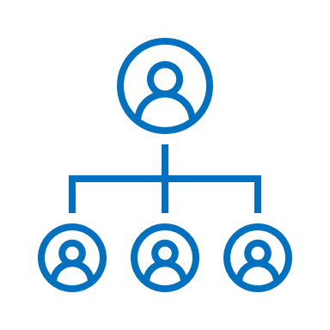
4.1 Why The Threat Model Was Wrong
Fairly straightforward human factors
computer security
team
Organizations with no computer security team
Many organizations have no computer security team at all.

Slide 21
4.1 Why The Threat Model Was Wrong
Regularly reorganized security team
Computer Security
Team
Security teams tend to be ‘reorganised’ regularly leading to a loss of continuity. For example, that the average tenure of computer security managers at US government agencies is only seven months.

Slide 22
4.1 Why The Threat Model Was Wrong
Corporate politics
Computer Security
Team
They can have an even worse effect while technical staff are aware of a security problem, they often keep quiet for fear of causing a powerful colleague to lose face.

Slide 23
4.1 Why The Threat Model Was Wrong
Consultants service
Most banks buy their consultancy services from a small number of well-known firms, and value an ‘air of certainty and quality’ over technical credentials. Many of these firms pretend to expertise which they do not possess, and cryptology is a field in which it is virtually impossible for an outsider to tell an expert from a charlatan.

Slide 24
5. A New Security Paradigm
Are aware of the shortcomings of traditional approaches to computer security
New paradigms
Journal Papers
Need to focus on what is likely to happen than what is possibly go wrong

Slide 25
5.1 A new metaphor
Computer Security
Safety Critical Systems
There is also an interesting technical duality, in that while secure systems must do at most X, critical systems must do at least X.

Slide 26
6. Conclusions
Cryptography systems fail by some reasons:
Designers of the systems couldn’t know how their systems fail
- Led to a false threat model
Designers focus on what could possibly go wrong, rather than what was likely to.
Products are made so complex and tricky to use
Implement and management errors.

Slide 27
Thank you!
Q&A

